Slide 1

Suction Harvesting
Myths vs Methodology
Presented by Jerry Davis, President:

Slide 2
Qualifications & Background
*Involved in Suction Harvesting Since 1998
*Founded Aquacleaners in 2000
*Developed numerous variations of DASH BOATS
*Developed Operational Protocols for SH in NYS
*Removed over 500 Tons of Aquatic Vegetation in 1 season

Slide 3
Introduction
Suction harvesting AKA, “DASH”, is the extraction of plants using a diver, suction tube, unique set of pumps mounted on a boat, and a bagging or filtration system. The system is used to remove invasive, annoying, and overrun plants by the rooting system as well past year’s plants lying on the bottom in various forms of decomposition. Suction harvesting is a viable means of plant suppression, as you are removing the entire plant in its connective rooting system.

Slide 4
History
The diver dredging procedure is a mechanical control technology that was pioneered by the British Columbia Ministry of Environment after Eurasian water milfoil invaded its waterways in the early 1970s.
Diver dredging is especially effective against pioneering infestations of submersed invasive plant species. When a weed is discovered in a pioneering state, this methodology should be considered.

Slide 5
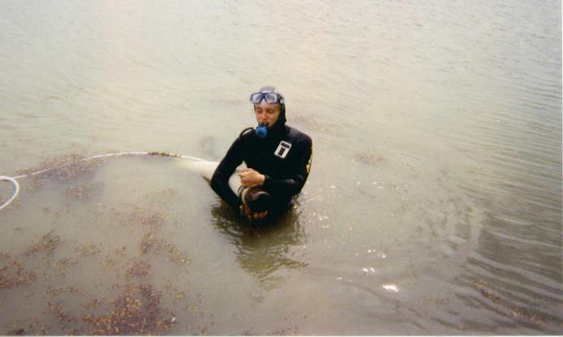
Components: DASH BOAT
Diver
Notes:
Everything Starts with the Diver. The Rate of Progress, Re Growth and Ability to Handle different Plants and Bottom Materials

Slide 6
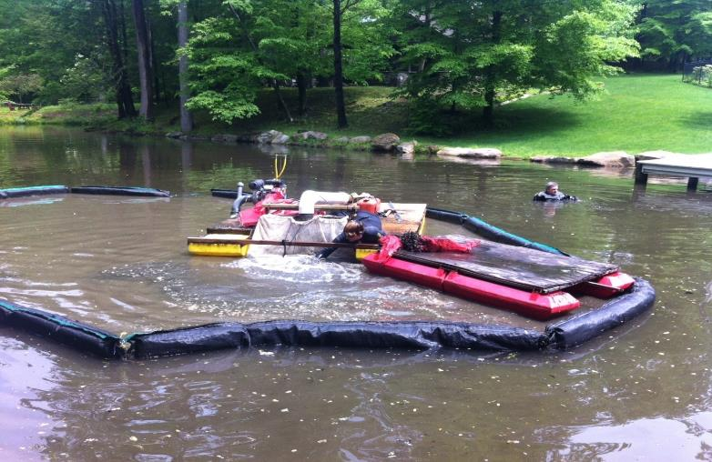
Pumps & Barges

Slide 7
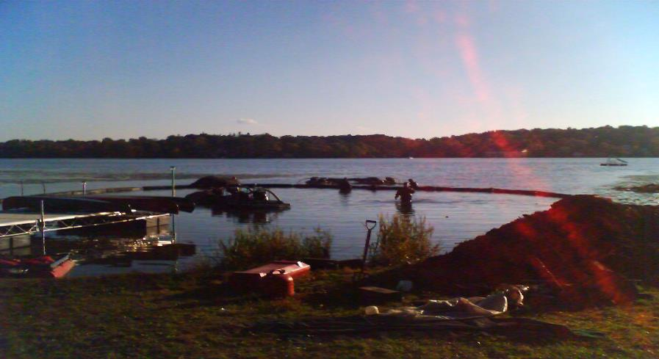
Turbidity Curtain
Notes:
Curtains are deployed to keep the minimal turbid water generated by this process contained around the work barge. It also assures that any fragments that may escape the bagging system, are not allowed to spread around the watercourse.

Slide 8
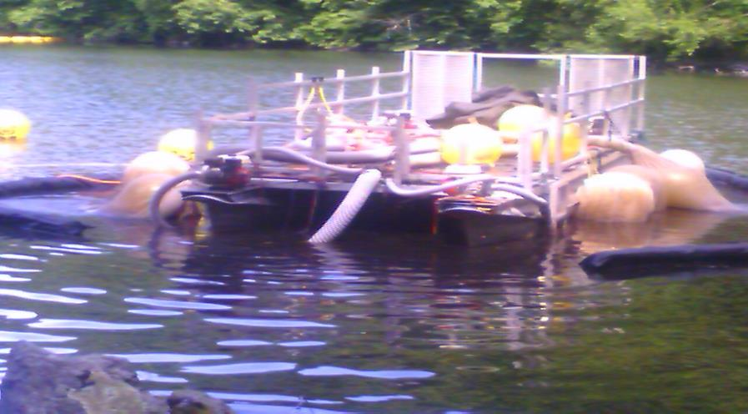
Bagging System
Notes:
Our duel nozzle pump barge uses very large filtration bags that allow us to increase our productivity and rate of progress significantly.

Slide 9
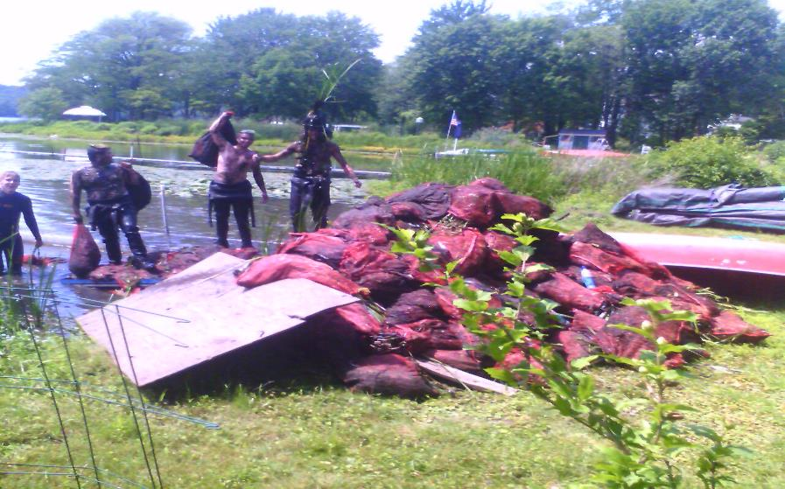
ONION BAGS
Notes:
These smaller filtration bags allow easy removal out of the water in close proximity to the pumping sites.

Slide 10
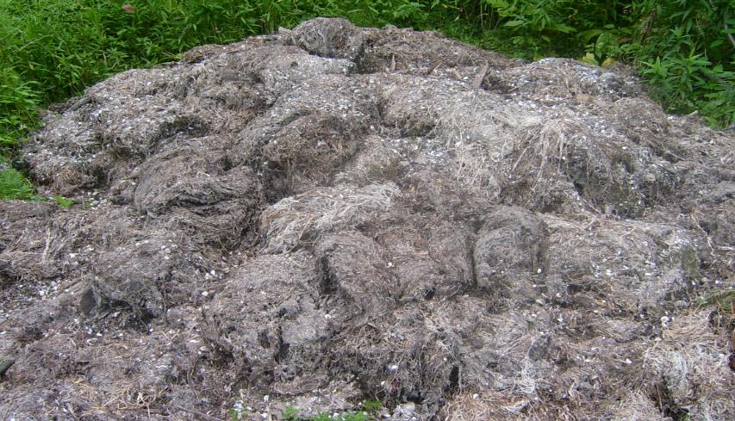
SPOILS PILE
Notes:
This is an example of the spoils generated by a days harvesting with our duel nozzle suction harvesters and large filtration bags

Slide 11
States Using DASH BOATS
Vermont
Maine
New Hampshire
Connecticut
New York
Washington
Michigan

Slide 12
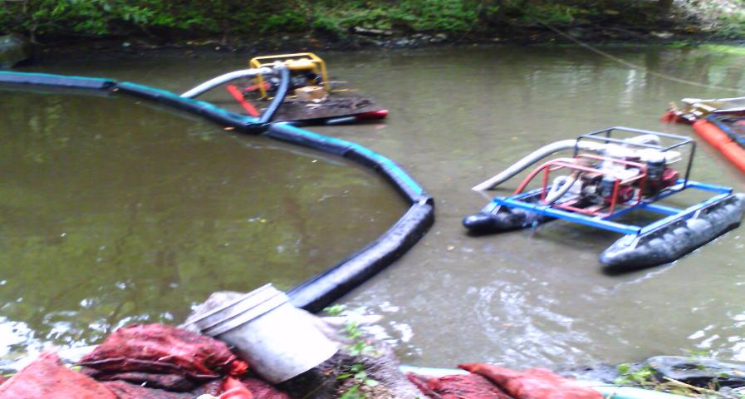
Water Quality
Notes:
The use of Turbidity Curtains can easily contain the turbid water generated from our sediment removal system

Slide 13
Water Quality Study
Notes:
It is Worth Noting that the spikes in the chart occurring on 7/29 occurred on a day when we weren’t working because of a heavy down pour. It’s clear to see that a hard rain fall caused significantly higher spikes in total phosphorus and suspended solids that our suction harvesting activity.

Slide 14
Effective For Suppression
Eurasian Milfoil Water & Variable
Fan Wart Brazilian Elodea
Curley Pond Weed Hydrilla
Lily Pads Chara
Removal of the existing plants and it’s associated rooting system is key for suppression.

Slide 15
Determining Rates of Progress
Rates of progress for suction harvesting can be determined once a better understanding of dynamics involved have been properly assessed, because each factor can have a major impact on just how big an area can be completed in a hour, day or week.
Plant & Debris Removal
Type of plant: The Rooting System of aquatic plants varies and dictates how fast we can remove this year’s plants. Tuber rooted plants like lily pads can significantly reduce productivity due to their size and structure.

Slide 16
Rates of Progress
The Type of Bottom – Soft, silted in bottoms will make plant removal and it’s rooting system easier to extract. Hard bottoms like clay or sand will require more suction to get to the rooting system of the plant.
The Density - Is a patch sparse or are patches thick.
The Height of the Plants – The taller the plants is, the more time will be required to extract it in a given area because there is more bio mass. The difference between a 3’ and 12’ plant is 4 times the mass.

Slide 17
Rates of Progress
The Depth of the Water is important because deeper water work will slow your rate of progress due to the logistics of moving around while under water.
How Long Has The Patch Been Established – The longer the plants have been established, the more dead plants will be lying in the lakes bottom and the more mass and time to remove it
Define The Other Types of debris in the area to be cleaned. Leafs, sticks, rocks, zebra mussels, and larger timber must be gone through as we clean an area and the thickness of these other types of debris will effect the rate of progress.

Slide 18
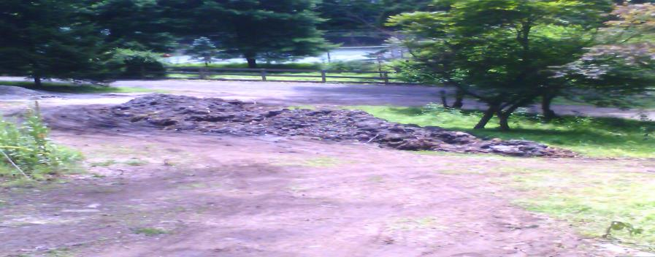
Determining Rates Of Progress
Rate of Progress can vary from 50 square feet/hr (Tuber Rooted Plants) to 500 square feet/hr (Curly Pond Weed, Milfoil) depending on these characteristics

Slide 19
Suction Harvesting Applications
*Invasive Plants *Over Run Aquatic Vegetation
*Rapid Response *Shoreline Remediation
*Large Scale Projects *Waterfront Homeowners
Shoreline Remediation – The Removal of leaves, sticks, rocks and debris along from the shoreline and out into the lake.

Slide 20
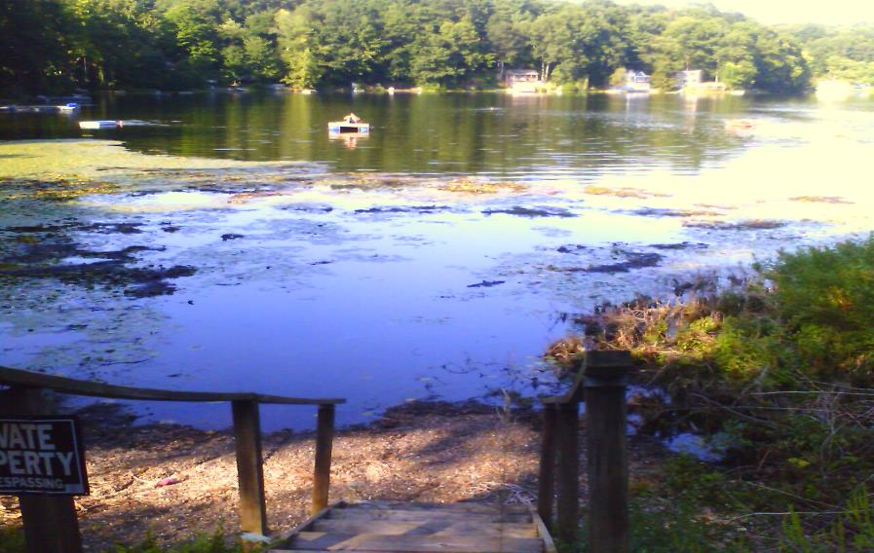
Shoreline Remediation BEFORE

Slide 21
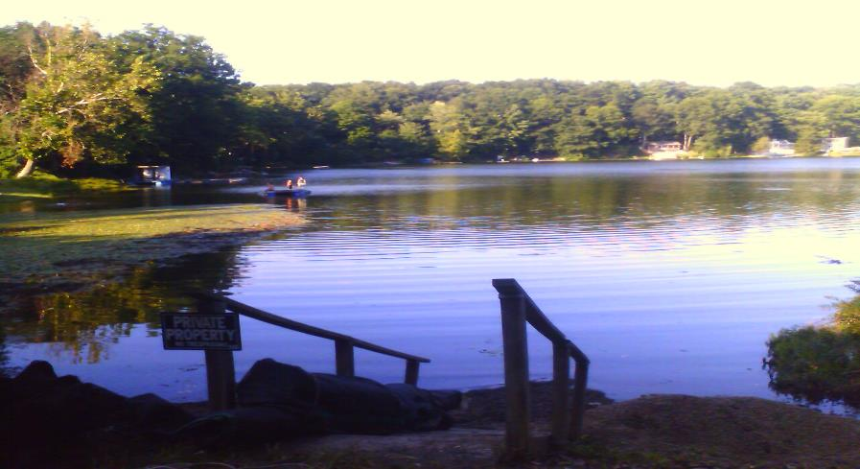
Shoreline Remediation After

Slide 22
SUCTION DREDGING
Bigger is not always Better

Slide 23
Facts & Stats of Dredging
Traditional Dredge Methods
*Two Methods of Dredging: Excavation & Pumps
*Dredging Was Designed to Deepen Waterways & Alter Bottom
*Excavation is Imprecise, Messy, Logistically Challenging
*Large Pumps Need Space To De Water, Large Set Up Costs
*Permitting Can be Problematic
*Small Scale Projects More Costly
*Large Disruption in the Water & Upland
*Harder to Contain Turbidity
*Tougher To Work Close To Shore & Around Docks

Slide 24
Aquacleaner
Suction Dredging
An Extension of Suction Harvesting removing the Accumulated Organic Sediment
*Diver Operates Nozzle Under the Water
Low Short Term Impact in the Water
Low Short Term Impact Up Land
Minimum Disruption During Project
Can Reclaim the Natural Bottom
A Green Alternative vs Traditional Dredging
Minimal Set Up & Break Down

Slide 25
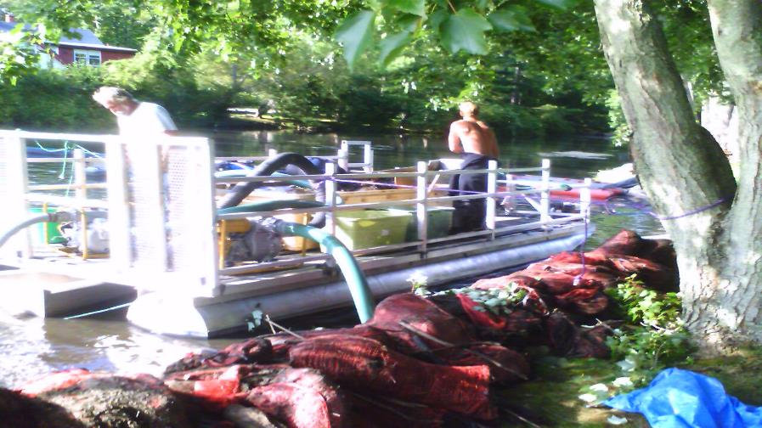
Removal in The Lake
Dirty Dredger For Removal of Plants & Sediment

Slide 26
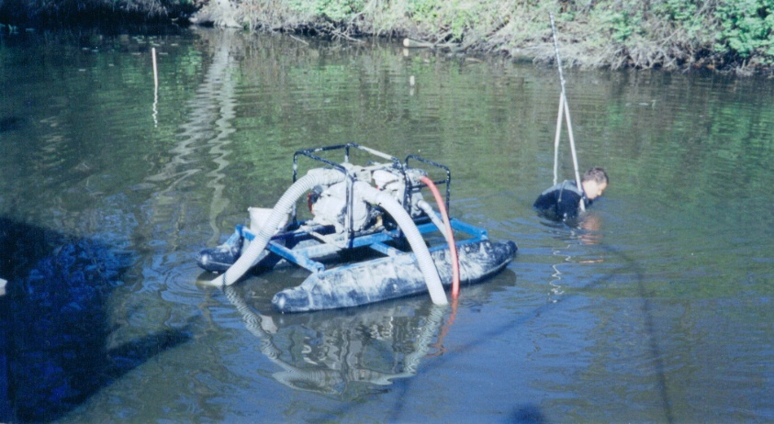
Aquacleaner Pole Dredger

Slide 27
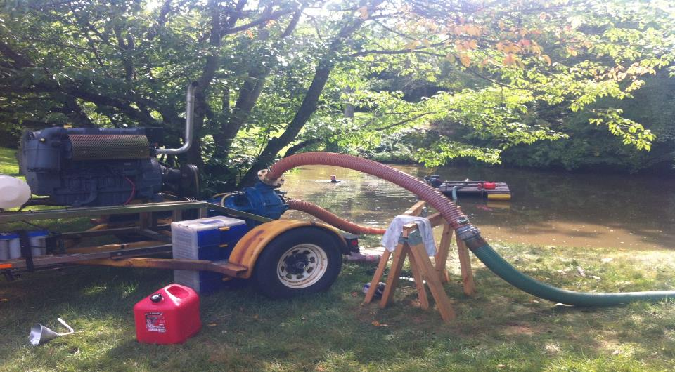
Diver Assisted Suction Dredge

Slide 28
Upland Staging Area
Slurry Is Pumped To Shore Where the Material is Separated Components & Benefits
Hay Bail Containment Area
Liner is Placed Underneath the Bag
Filtration Material is Placed Inside Hay
De-Watering Bag is Placed Inside Burm
Return Water is Managed so to Minimize Disruption
Material Remains in Bag Till Dry
No Smell
Bag Sized to Fit Project & Space

Slide 29
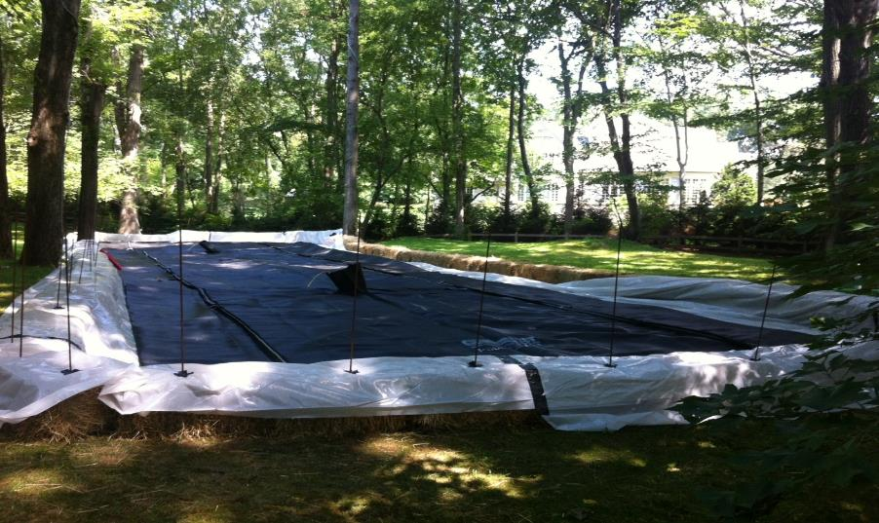
Staging Area Set Up

Slide 30
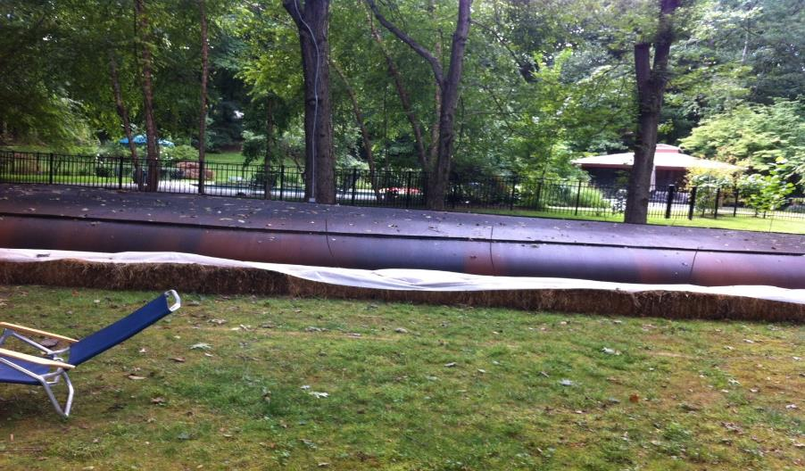
Staging Area in Use
Notes:
This De Watering Bag was set Up and Managed material in and Clean Water Out 30’ away from a $250,000 in ground swimming Pool

Slide 31

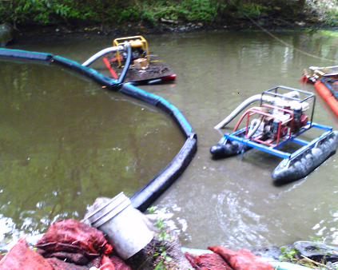
Suction Dredging in Progress

Slide 32
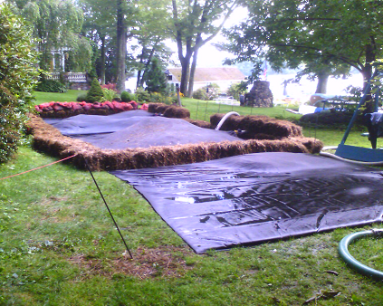
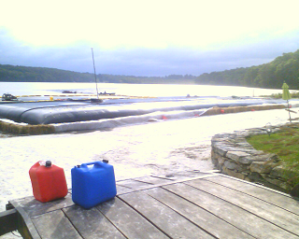
Various De-Watering Bags

Slide 33
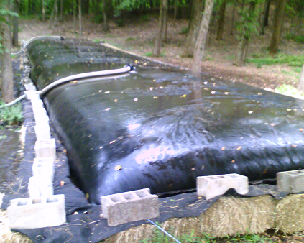
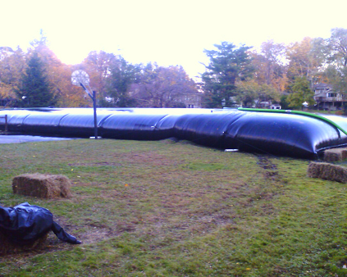

Slide 34
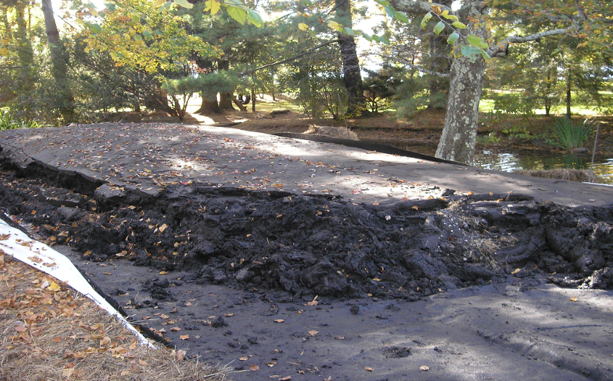
De-Watering Bag After

